Slide 1
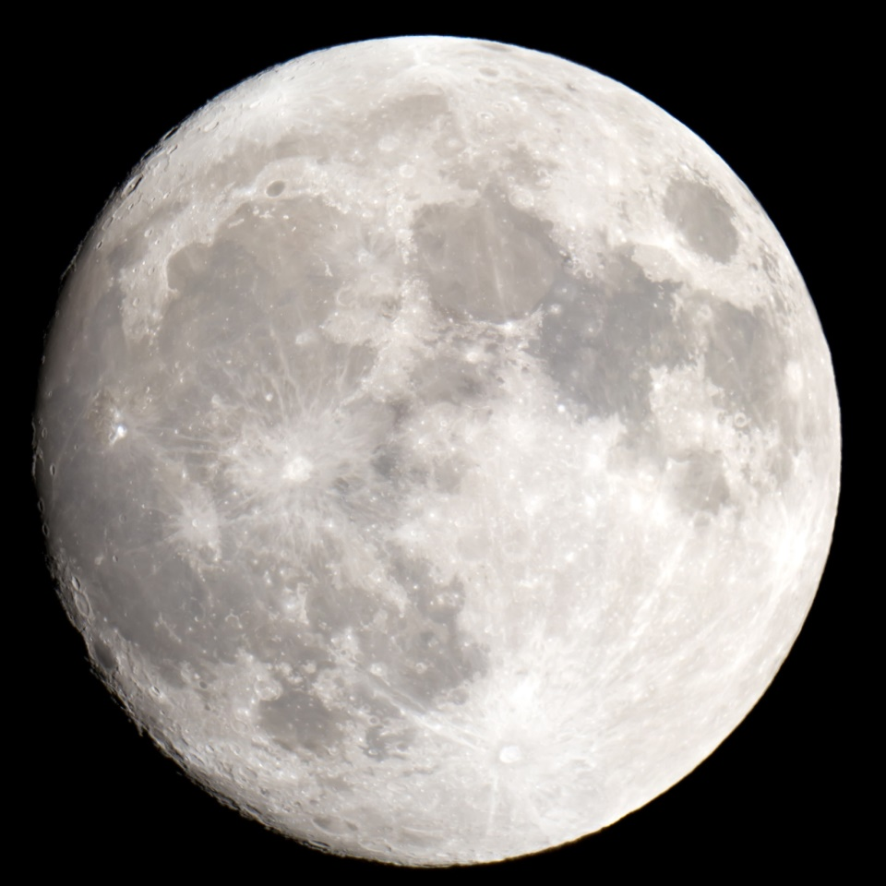
Big Bang Theory
Presented by Kesler Science
Notes:
Created by Kesler Science – More 5E lessons at KeslerScience.com

Slide 2
Essential Questions:
What scientific evidence is used in constructing an explanation of the Big Bang Theory?

Slide 3
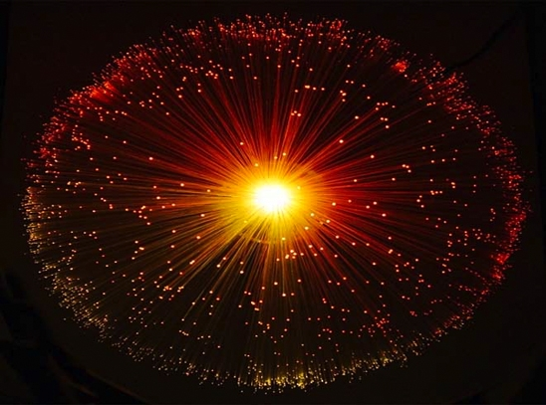
Big Bang Theory
Most Scientists Believe:
The universe is finite and expanding.
All matter, energy, and space was once squeezed into a very small volume.
This resulted in a sudden expansion known as the Big Bang.
The name is misleading because it was not an explosion as we think of an explosion.
© KeslerScience.com
Notes:
Explosions are the free expansion of material from higher, pressure, temperature and density to lower pressure, temperature and density in a short amount of time.
The big bang was the expansion of the space time manifold from a singular point at time equals zero to a four dimensional manifold growing with time. In the process the contents of the universe expanded to fill the new space that was created after the big bang.
The big bang was not an explosion because no material was involved. None existed yet. The big bang was the sudden expansion of space-time. That is not the same as an explosion in any physical sense.

Slide 4

Big Bang Theory
Most Scientists Believe:
Occurred 13.7 billion years ago
Galaxies expand throughout the universe like raisins baked in a cake.
They become more distant from each other as the cake rises.
It’s the cake (space) that is expanding causing the raisins (galaxies) to move.
© KeslerScience.com

Slide 5
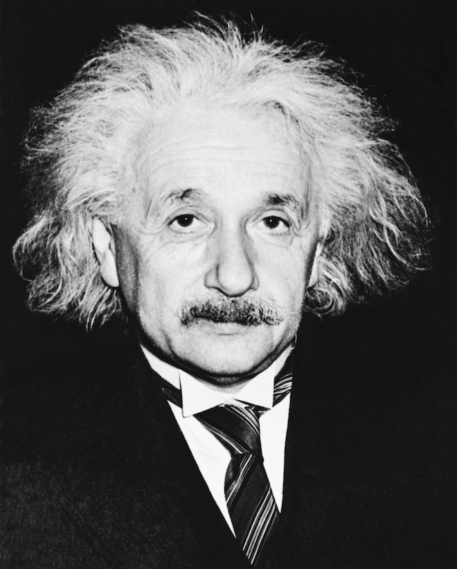
Big Bang Theory
Important Theories
Albert Einstein’s General Theory of Relativity and Sir Isaac Newton’s original Theory of Gravity concluded the universe was static (lacking movement).
This was later proved untrue and Einstein would call it his “biggest blunder.”
© KeslerScience.com

Slide 6

Quick Action – Big Bang Theory
Say Something
Discuss with a partner what scientists believe about the Big Bang Theory.
Are there other misconceptions about the theory that you have thought to be true?
You will learn three key pieces of evidence supporting this theory.
© KeslerScience.com

Slide 7
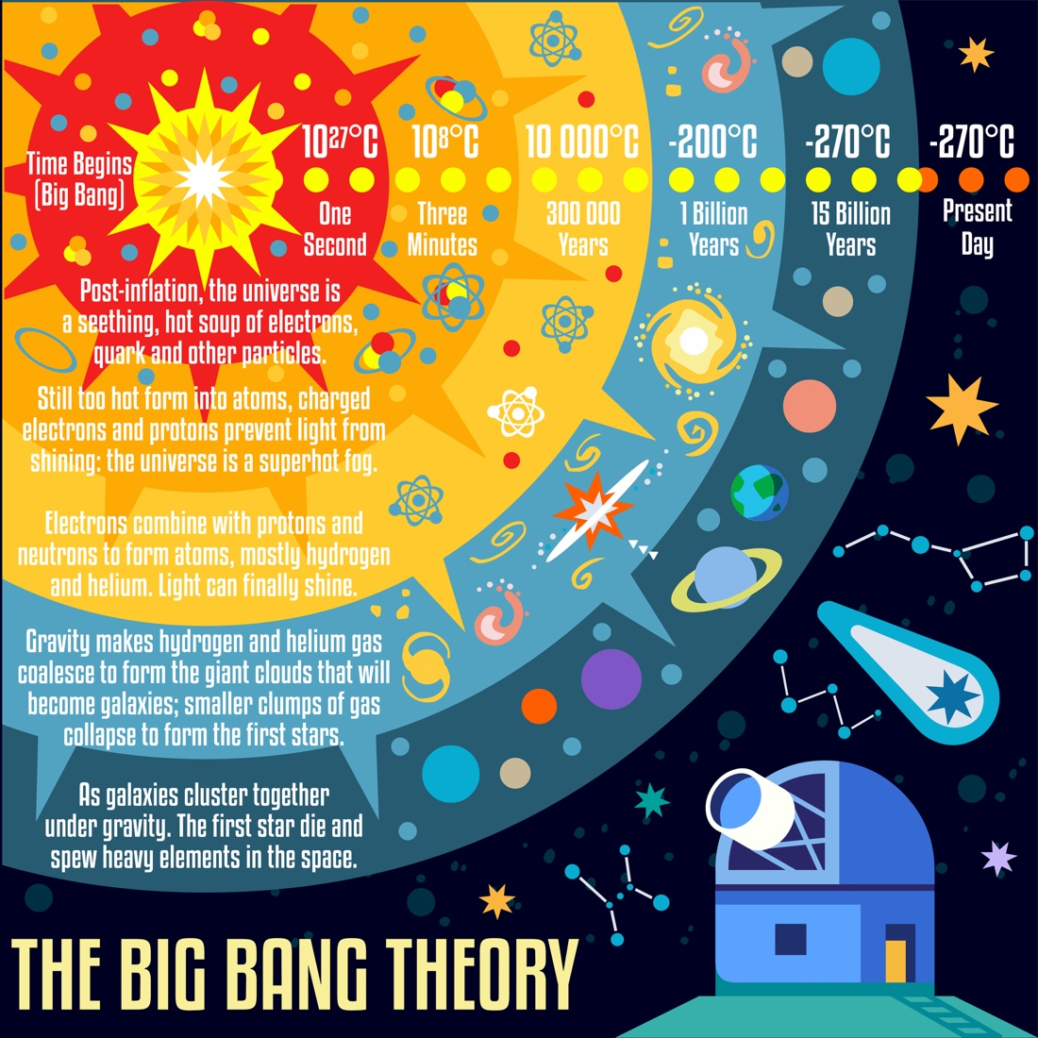
Class Discussion
Discuss as a class
What does this infographic represent?
What is happening to the temperature as the universe expands?
When were atoms created and how?
How long did it take for planets to be created?
What force allows stars and galaxies to be created?
© KeslerScience.com

Slide 8
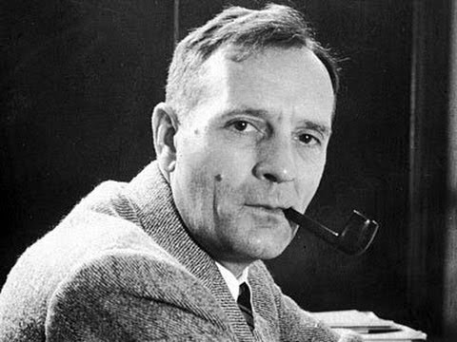
Big Bang Theory
Edwin Hubble
1929 – Discovered an electromagnetic property called the Red Shift
Explained why galaxies appear to be accelerating away from each other
Contrary to Einstein the Universe was expanding
© KeslerScience.com

Slide 9
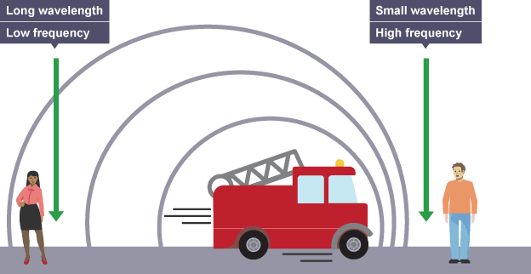
Big Bang Theory
Red Shift
Think of the Doppler Effect when a fire truck passes.
The sound waves are compressed in front of the train and make a high frequency sound.
After the fire truck passes, the wavelengths spread out making a low frequency sound.
© KeslerScience.com

Slide 10
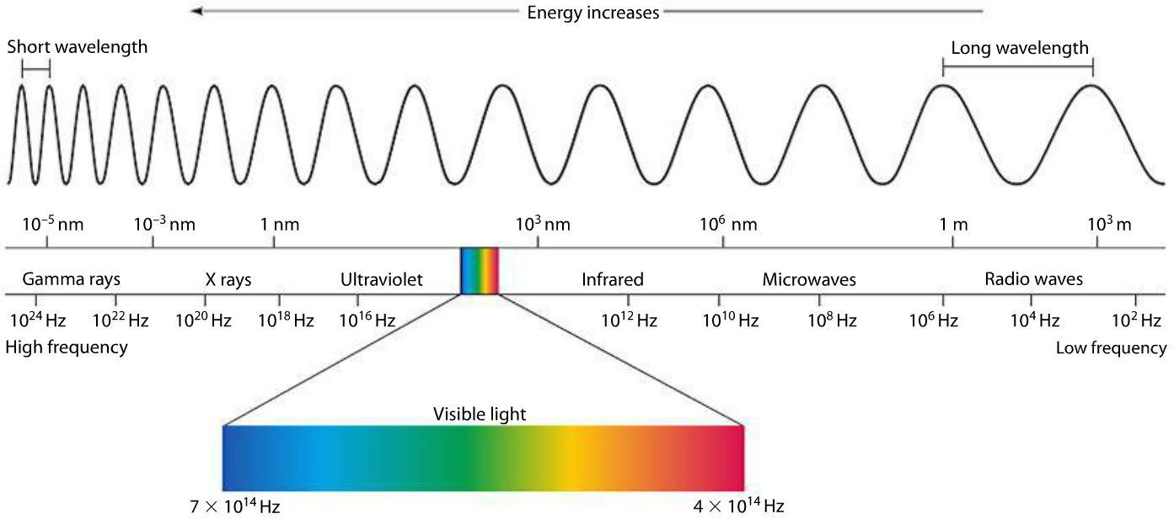
Big Bang Theory
Red Shift (cont.)
Light emitted from a star or galaxy can be separated into a band of colors, called a spectrum.
Each color has a different wavelength just like sound has wavelengths.
Notice the longer wavelengths are toward the red end of the spectrum.
Electromagnetic Spectrum
© KeslerScience.com

Slide 11
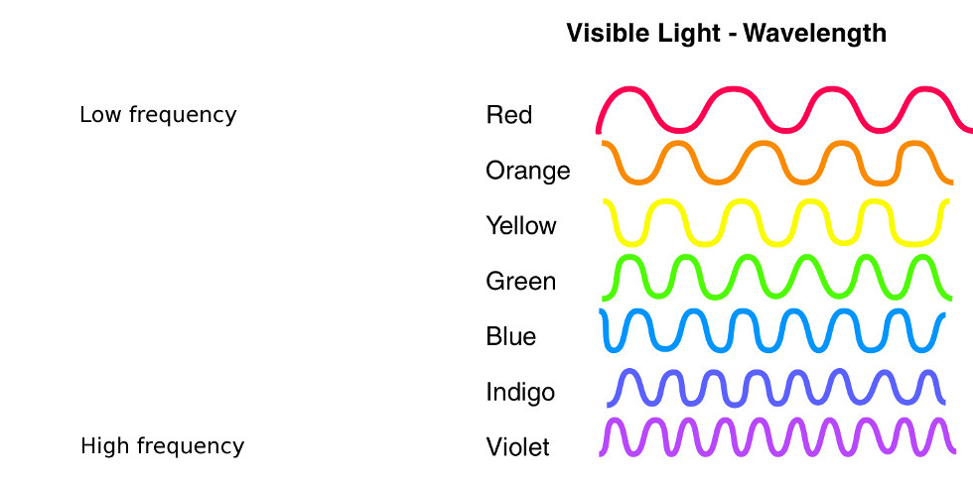
Big Bang Theory
Red Shift (cont.)
Light behaves like sound.
Just like sound, light has “pitch”.
The red end of the spectrum has a lower pitch, or frequency, than the blue end.
Think of it in sound terms, red colors are the low notes and blue colors are the high notes.
© KeslerScience.com

Slide 12
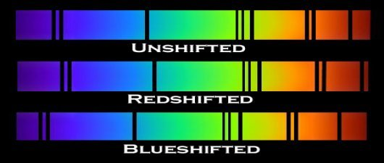
Big Bang Theory
Red Shift (cont.)
If a star is moving away from us, the light gets stretched out.
This makes it appear more red than it really is.
If a star is moving toward us, the light gets squeezed.
This makes it appear more blue than it really is.
The dark black lines called absorption lines represent the chemical elements in a star, which is used for identification, like a fingerprint.
© KeslerScience.com

Slide 13
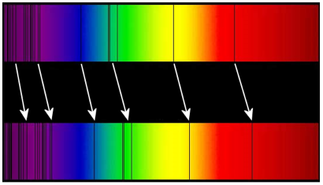
Big Bang Theory
Red Shift (cont.)
This shift in the absorption lines of galaxies lead Hubble to conclude that the galaxies are moving apart from each other.
Space is actually expanding causing the galaxies to move with it.
First piece of evidence supporting the BBT
Absorption lines shifted to the red end of the spectrum. This is called a Red Shift.
© KeslerScience.com

Slide 14

Quick Action – Big Bang Theory
Experiment
Take a rubber band and cut it in half
Lay the rubber band out and draw a wave across it. The rubber band represents space.
Mark four dots to represent four different galaxies.
Notice the distance between the dots with the rubber band and the wavelength at rest.
Now stretch the rubber band and observe what happens to the distances between the galaxies and the wave length.
As space expands the galaxies are along for the ride.
How does this relate to the Red Shift?
© KeslerScience.com
Notes:
Model this demo for the class before handing out the supplies.

Slide 15
Big Bang Theory
Cosmic Microwave Background Radiation (CMB)
Scientists thought if there was a BB, then there must be remnants of energy left out there in the far reaches of the universe.
This energy was found in the form of microwaves and is coming at us from every point in the universe.
It was called “relic” radiation.
© KeslerScience.com

Slide 16
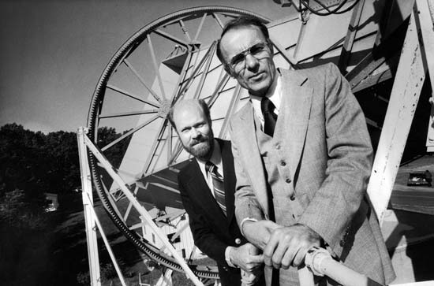
Big Bang Theory
CMB (cont.)
In the mid 1960’s, and totally by accident, two young scientists picked up mysterious microwave static coming from every direction in the sky.
This radiation was very cold, which was expected.
They concluded it must be the “afterglow” of the BB.
This is the second piece of evidence supporting the BBT.
Arno Penzias and Robert Wilson
And that, my friends, is how you win a Noble Prize!
© KeslerScience.com

Slide 17
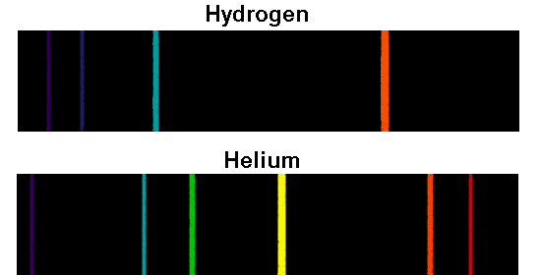
Big Bang Theory
Hydrogen and Helium
Using powerful telescopes, scientists have concluded the universe consists of mainly hydrogen (74%) and helium (25%).
These are the lightest elements. Heavier elements make up the other 1%.
This continuity throughout the universe supports the BBT.
Third piece of supporting evidence for the BBT
Fingerprint of hydrogen and helium
© KeslerScience.com
Notes:
Scientists have used spectroscopic surveys of distance galaxies and identified the elements in those body.
Point out H and He on Periodic Table as being the lightest elements
Doing some flame testing with enhance this unit.
The characteristic pattern of dark lines or bands that occurs when electromagnetic radiation is passed through an absorbing medium into a spectroscope. An equivalent pattern occurs as colored lines or bands in the emission spectrum of that medium

Slide 18
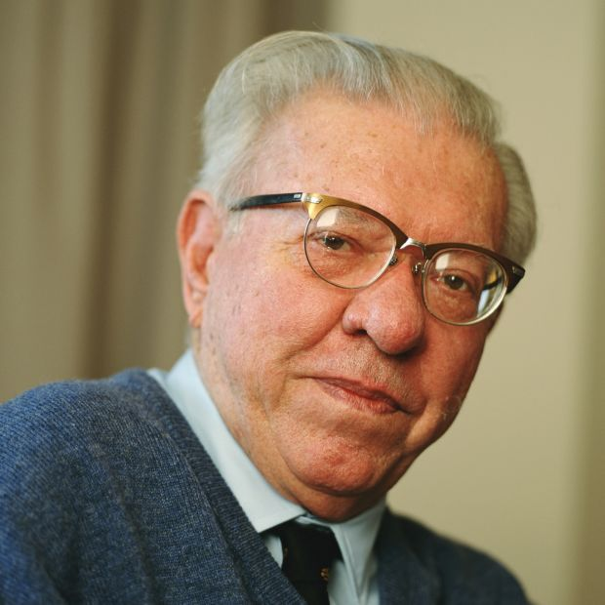
Big Bang Theory
Fred Hoyle
English astronomer, Fred Hoyle, coined the phrase Big Bang in 1949.
Most scientists consider it to be the most likely scenario for the birth of the universe.
There is much more supporting evidence, which is not included in this lesson.
© KeslerScience.com

Slide 19

Check for Understanding
Can you…
Explain three pieces of scientific evidence used in constructing the Big Bang Theory?
© KeslerScience.com
Notes:
Clear up any confusion and answer questions.

