Slide 1
States and Form of Energy
PS. 6 Notes

Slide 2
Greetings and Salutations
Make sure that you grabbed the sheets as you entered the room!
Consider this and discuss:
  What were the hardest parts of the pretest?
  What did you know and what didn’t you know?

Slide 3
SNAPSHOT
Today I will complete a T-chart with descriptions of kinetic and potential energy,
So I can differentiate between kinetic and potential energy.
I know I have it when we have provided 10 examples of kinetic and potential energy!

Slide 4

What is Energy?
Everything in the world can be classified as either matter or energy.
Energy is the ability to do work. Work takes place when energy is transferred to an object causing it to move or change. Energy is measured in Joules (J).
When a baseball player swings a bat, he transfers energy to the bat causing it to move.

Slide 5
Kinetic and Potential energy
Kinetic energy is the energy of motion.
Kinetic energy depends on the mass and velocity or speed of the object. Kinetic energy increases as speed, velocity, or mass increases.
The amount of kinetic energy depends on the mass and velocity of the moving object.

Slide 6
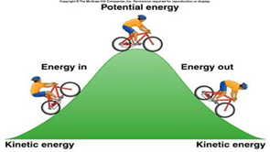
Kinetic & Potential energy
Potential energy is stored energy. When an object is sitting still, it has energy stored inside that can be turned into kinetic energy (motion).
Potential energy can be based on position. Any object that can fall (pulled by gravity) has stored energy.

Slide 7
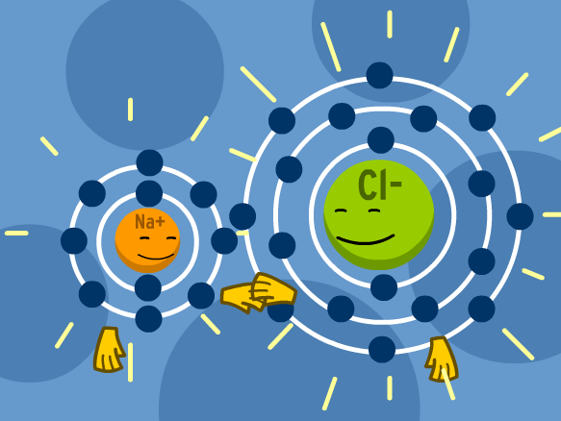
Kinetic & Potential energy
Potential energy can be based on chemical composition. Food, oil, gasoline, and wood have potential energy that is stored in the chemical bonds between their atoms. When the bonds are broken and reformed, energy is released.

Slide 8
Forms of energy
Radiant energy consists of electromagnetic energy that moves in waves. These waves allow you to see the world around you.
  Radiant energy includes visible light.
Thermal energy (heat) is caused by the kinetic energy (movement) of the molecules within an object.
  The faster the particles move, the more heat energy is produced

Slide 9
Forms of energy
Chemical energy is the energy that is located in the chemical bonds within a substance.
  When these bonds are broken and reform, chemical energy is released.
Electrical energy is produced by moving electrons.
  When you plug an appliance into an electric outlet and turn it on, electrons travel back and forth through the wires.

Slide 10
Forms of energy
Mechanical energy is the total amount of potential and kinetic energy in a moving object.
  Sound is a form of mechanical energy. Sound energy is caused by vibrating objects.
Nuclear energy is found within the nucleus of an atom.
  Energy is released during nuclear fusion or fission.

Slide 11

Energy Transformations
Energy transformations take place all of the time as energy is converted or changed from one form to another.
When a person turns on a light, he transfers energy from the electrical socket to a wire attached to a lamp. The electrical energy transfers from electrical to radiant energy. Some of the energy is lost in the form of thermal (heat) energy.

Slide 12
States and Forms of Energy (PS.5a)
Pull out your binder
Write today’s date at the top of your note sheet!
Add your note sheet to your binder!

Slide 13
Potential Vs Kinetic Energy (T-Chart)
Potential Energy
What is the definition?
  Stored energy
What are types of potential energy?
  Chemical
  Gravitational
  Elastic
What are some examples?
Kinetic Energy
What is the definition?
  Energy of movement
What are types of kinetic energy?
  Electrical (moving electrons)
  Radiant (moving waves)
  Thermal (moving particles)
What are some examples?

Slide 14

Exit Quiz PS.5A
Energy is the ability to do work
  True b. False
Which of the following is NOT a type of energy?
  a. Electrical b. kinetic c. mechanical d. radical
A moving train is exhibiting potential energy.
  True b. False
Stored energy is potential energy and kinetic energy is the energy of motion.
  a. True b. False

