Slide 1
Force and Simple Machines
PS.8 Notes Part 2

Slide 2

Greetings and Salutations
Today, I will investigate force, work and power,
So I can explain how simple machines operate.
I know I have it when I calculate force, work and power accurately.

Slide 3
What is Force?
Force is simply a push or pull.
A force can cause objects to move, stop moving, change speed, or change direction.
All forces have a size and direction.
Force is measured using the newton (N).
The greater the force, the more newtons.

Slide 4
What is Force?
Applied force occurs when force (a push or pull) is applied to an object by another object.
Pushing or pulling a chair across the room.
Friction is the force that opposes the sliding motion between two surfaces that are touching.
Friction is what makes it difficult to slide your chair across the room.
Friction causes the work put into a machine to always be greater than the work output.

Slide 5
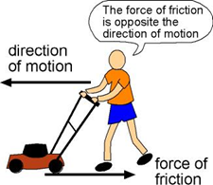
What is Force?
Net force is the sum of all the forces being applied to an object.
If you are trying to push a table across the room and a friend decides to help you by pulling the table in the same direction, the two forces add up to enough force to move the table.
Adding these two forces together equals the net force.

Slide 6
Mass vs. Weight
Mass is the amount of matter in an object.
Gravity is a force of attraction between objects that depends on the mass of the objects.
Weight is a measure of the gravitational force acting on the mass of an object.
Weight is a measure of the force of gravity, so it is measured in newtons (N).

Slide 7
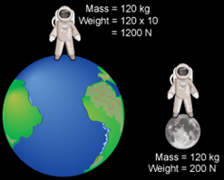
Mass vs. Weight
Mass is related to how much “stuff” there is and weight is related to the gravitational pull of the Earth on that “stuff. “

Slide 8
Force, Mass, and Acceleration
Acceleration takes place when an object’s velocity changes.
The amount of acceleration that takes place depends on the size of the force and the mass of the object.
Force = mass x acceleration (F = ma)
As mass increases, acceleration decreases.
As force increases, acceleration increases.

Slide 9
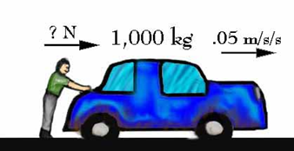
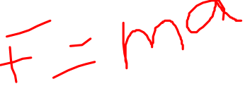
Force, Mass, and Acceleration
F = ?
m = 1000 kg
a = 0.05 m/s²
F = 50 N

Slide 10
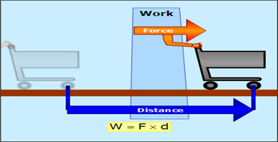
Work
Work occurs when a force is applied to an object and the object moves in the direction of the applied force.
Work = force x distance (W = Fd)
Work only takes place if a force makes an object move in the direction of the force.

Slide 11
Power
Power is the amount of work done in a set period of time.
It is the rate (speed) at which work is done or how fast work occurs.
Power = work/time (P = W/t)

Slide 12
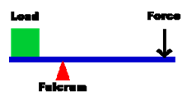
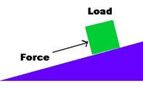
Simple Machines
Machines are devices or tools that make work easier. The six simple machines include
Lever, inclined plane, screw, wheel and axle, wedge, and pulley.
LEVER
Inclined Plane

Slide 13
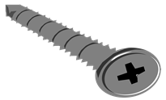
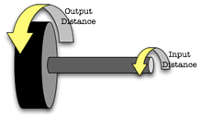
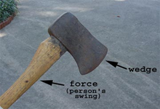
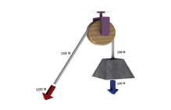
Simple Machines
Screw
Wheel and Axle
Wedge
Pulley

Slide 14
Simple Machines
Simple machines have different purposes:
To change the direction or distance through which the force is applied.;
Using a cord to lift a window blind (pulley)
To change the speed at which the resistance moves;
Using a broom or bat to move objects (lever)
To change the effort needed (mechanical advantage).
Using a car jack to move a car upward (lever)

Slide 15
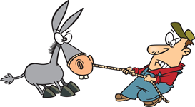
Simple Machines
Mechanical Advantage is the ratio of a machine’s output force produced to the input force.
Friction makes doing work harder.
Efficiency is the measure of how much of the work you put into the machine is changed into energy that the machine uses to do work.
The more efficient a machine is, the less heat it produces through friction.

Slide 16
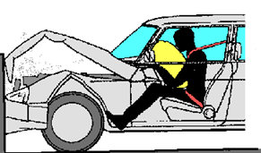
Current Technologies
Seatbelts and airbags protect us from injuries that would be caused by Newton’s first law of motion.
Without these restraining devices, our bodies would continue to move forward during sudden stops or crashes.
Headrests are placed in cars to prevent neck injuries during rear-end collisions.
Crumple zones are located in the front and rear sections of a car and act like pillows during a crash.

Slide 17

Current Technologies
In order for a rocket to escape the pull of Earth’s gravity, it must exert a tremendous force.
The force of burning fuels and gasses pushes against the Earth.
This illustrates Newton’s third law of motion: for every action there is an equal and opposite reaction.

Slide 18
Current Technologies
As the rocket rises into the atmosphere it continues to burn off its heavy supply of fuel and ejects its booster engines.
As the mass decreases, it is able to move faster.
This illustrates Newton’s second law of motion: the acceleration of an object depends on its mass and the force applied.

Slide 19
Current Technologies
The rocket will break free from the Earth’s gravitational pull. At that point, it can shut off its engines and continue to move forward.
This illustrates Newton’s first law of motion: a body in motion remains in motion.

Slide 20
Force, Work and Power Practice Problems
Complete the practice problems on the worksheet before the end of class.
Use the calculators provided.
Turn in your sheet to the mailbox!

