Slide 1
What is Matter?
The particle Theory of Matter and the Phases of Matter!

Slide 2

Mastery Objective
Today, I am investigating matter and its properties,
So I can describe the particle theory and state of matter.
I know I have it when I earn at least 75% on the Exit Quiz #9.

Slide 3
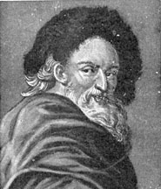
The Particle Theory of Matter
As you look around the classroom, you will find many forms of matter.
Over time, many scientists have created theories that describe matter and its properties in different substances. Theories are statements developed to explain observations of our natural world.
Democritis proposed the theory that all substances are composed of very small particles that are too small to be seen by the human eye.
We call these particles atoms.

Slide 4
Particle Theory of Matter
Matter is anything that has mass and volume (takes up space).
Tiny particles that create the mass of a substance and take up space are called atoms.
Scientists use the Kinetic or Particle Theory of Matter to help explain the properties and characteristics of different substances on Earth.

Slide 5

Particle Theory of Matter

Slide 6
Particle Theory of Matter
1. All matter is composed of extremely small particles.
2. All particles of one substance are the same. Different substances contain different particles.
3. These particles are always moving. They rotate, vibrate, or travel in straight lines. When energy, like heat, is added to these particles, they move faster.
4. There are spaces between the particles. When energy is added, particles tend to move farther apart.
5. The particles in a substance attract one another. The slower the particles move, the stronger their attraction to each other. The stronger the attraction, the closer together the particles become.

Slide 7
The Phases of Matter
Matter can be found in four phases of matter: solid, liquid, gas, or plasma.
All matter is composed of tiny particles or atoms that are attracted to each other and are in constant motion.

Slide 8

The Phases of Matter

Slide 9
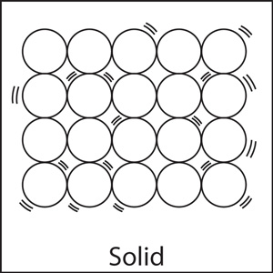
Solids
In solids, these particles move so slowly, they cannot overcome their strong attraction to each other.
This attraction causes them to be packed tightly together.
They are so close together, they can only vibrate in place.
As a result, solids have a ­­­­definite shape and a definite volume.

Slide 10
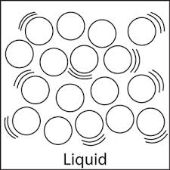
Liquids
In liquids, particles move quickly enough to overcome some of their attraction to each other.
These particles are able to slide past each other, unlike solid particles.
As a result, liquids have an indefinite shape and flow to take the shape of the container that is used.
Liquids do have a definite volume.

Slide 11
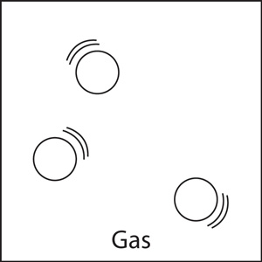
Gases
In gases, particles are widely spread out and are moving around very rapidly.
Gas is the only phase of matter that is highly compressible, like how we can squeeze and stretch balloons filled with helium or air.
Gases have particles that flow and can be compressed, so gases have an indefinite shape and an indefinite volume.

Slide 12
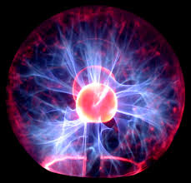
Plasma
The last and more recently discovered phase of matter is plasma.
Plasma makes up 99% of the universe including the star.
Plasma is not common on Earth although it does appear as lava from volcanoes and in fluorescent and neon lights.
Plasma has an indefinite shape and an indefinite volume.
Plasma has the unique ability to break electrons away from atoms such as in lightning.

Slide 13
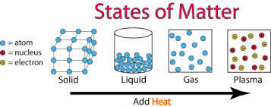
Changes in Phase
Changes in matter from one phase to another are caused by adding or taking away energy, such as heat.
When thermal energy or heat is added to a substance, the particles begin to move faster, lose their attraction, and space themselves farther and farther apart.
When the ­­­energy is removed, the particles slow down, become more attracted to each other, and move closer and closer together.

Slide 14
Particle Theory and Phases of Matter
Write the title above at the top of page 50.
Fold your Notes in Half
Glue them in On page 50

Slide 15
Exit Quiz #9
Write #9 next to the box for Exit Quiz #6
Exit Quiz 7 and 8 are glued into our notebooks.

Slide 16
Exit Quiz #9
Which of the following is a solid?
  a. Brick b. gasoline c. air d. fire
Which of the following is a gas?
  a. Brick b. gasoline c. air d. fire
Which of the following is a plasma?
  a. Brick b. gasoline c. air d. fire
Which of the following is a liquid?
  a. Brick b. gasoline c. air d. fire

Slide 17
You may begin your homework!!!
You may begin working on your worksheet (Homework)!

Slide 18
Day 2 Assignment
Pick up a sheet of card stock from the basket as you entered the room.
Use the sheet of card stock to create a chart/foldable of the Phases of Matter!
  Must have all 4 phases of matter!
  Must have the description of particle motion for each state of matter!
  Must have a description of the shape and volume for each state of matter!
  Must have 2 examples of each state of matter!
  Must have at least 1 picture of the particles for each state of matter!!
    Plasma – Draw magma or lightning!!!!!
Your card must be colorful and creative!!!!!
Due by the end of class today!!!!!

