Slide 1
Periodic Table Basics
How do we use this thing?????

Slide 2
Greetings and Salutations
Make sure you grabbed the sheets from the desk.
Pull out your agenda and copy your homework:
  Unit 4: Element Impact Project (Due Dec 10/11)
  Unit 4/5 Vocab
  Terms on pg 82, 92, and 100
Snapshot: Pull out your “30 Common Elements” worksheet for review
  Pull out the “Periodic Table Coloring Activity”

Slide 3
Let’s Add Some Stuff to Our Notebooks
Glue the following pictures into your notebook:
  “Periodic Table Map” on Page 34
  “30 Common Elements” on Page 35

Slide 4
30 Common Elements worksheet
When I call your name, hold your homework up for credit.
What should go in each section of the worksheet?
  Symbol can be found above the element name on the periodic table.
  Atomic number can be found above the symbol.
  Group can be found by numbering the columns of your periodic table and using your “Color Key”

Slide 5
What happened with the Unit 3 Test?
The test scores still need some improvement.
What is the reason?
  Wording of the questions?
  Did you read the questions thoroughly?
  Not studying?
  Is the information on the test missing from your notebooks?
What can I, Ms. Smith, or Mr. Smith do to help you?
  Use the parking lot board to write your real suggestions?

Slide 6
Element Impact Project
Project is due December 10th/ December 11th
Pay attention and write down the element that is given to you!!!
Be creative and make sure you are ready to present your project!!!

Slide 7
Mastery Objective
Today, I will…. describe the periodic table,
So I can….use it to gather information about the elements.
I know I have it when… I earn at least 75% on Exit Quiz #11.

Slide 8


Slide 9
What is the Periodic Table?
The periodic table is a chart of the elements arranged into rows and columns according to their chemical and physical properties.
The table can be used to determine how all elements are related to one another.

Slide 10
Developing the Periodic Table
In the 1800s, Dimitri Mendeleev created a table to help classify the elements by their properties.
  The elements were placed in rows of increasing atomic mass.
  The elements in the table showed repeating patterns (periodic describes these patterns).
In the 1900s, Henry Moseley organized the elements into rows by atomic number.
  The atomic number is the number of protons in the nucleus of an atom of an element.

Slide 11
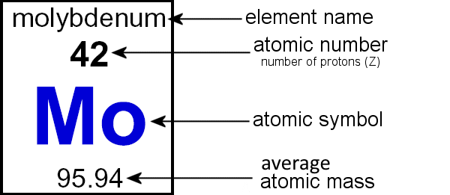
Element Key

Slide 12
The Current Periodic Table
The element key shows the element’s name, atomic number, chemical symbol, state of matter, and atomic mass.
A group is a column on the periodic table.
Elements in the same group have similar chemical properties, which means they react with other elements in similar ways.
The rows in the periodic table are called periods.
Reading from left to right across the periodic table, atomic number increases for each element.

Slide 13
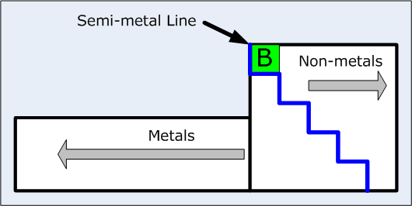
The Current Periodic Table:
Metals, Nonmetals, and Metalloids

Slide 14
The Current Periodic Table:
Most elements in the periodic table are metals.
  Metals are shiny and conduct thermal energy (heat) and electricity.
Most nonmetals are on the right side of the periodic table.
  Nonmetals do not conduct thermal energy (heat) and electricity.
Between metals and nonmetals on the periodic table are the metalloids.
  Metalloids have properties of metals and nonmetals.

Slide 15
Metals, Nonmetals, and Metalloids

Slide 16
Metals
Metals are elements that are generally shiny, are easily pulled into wires or hammered into thin sheets, and are good conductors of electricity and thermal energy (heat).
Luster describes the ability of a metal to reflect light.
  Shiny is high luster or Dull is low luster

Slide 17
Metals
Copper is a good conductor of thermal energy and electricity that is commonly used in cookware.
Ductility is the ability of a substance to be pulled into thin wires.
Malleability is the ability of a substance to be hammered or rolled into sheets.
Except for Mercury, all metals are solids at room temperature.

Slide 18
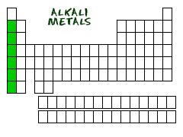
Group 1: Alkali Metals
The elements in group 1 of the periodic table are the alkali metals. They include lithium, sodium, potassium, rubidium, cesium, and francium.
Alkali metals react quickly with other elements, so they only exist in nature as compounds.
Pure alkali metals are silver in color. They are very soft and have low density.

Slide 19
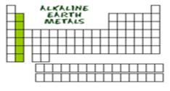
Group 2: Alkali Earth Metals
The elements in group 2 of the periodic table are the alkali earth metals. They include beryllium, magnesium, calcium, strontium, barium, and radium.
Alkaline earth metals are not quite as reactive as alkali metals. Still, they occur naturally only as compounds.
Alkaline earth metals are silver in color, similar to alkali metals.

Slide 20
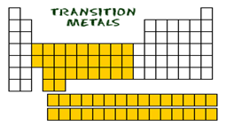
Groups 3 – 12: Transition Metals
The elements in groups 3-12 of the periodic table are the transition metals.
The transition metals are located in the center of the periodic table and the two rows at the bottom of the periodic table.

Slide 21
Groups 3-12: Transition Metals
Main-block transition metals such as iron make good building materials.
Main-block transition elements react with other elements and form colorful compounds, some of which are used in paints and pigments.

Slide 22
Nonmetals
Most of the mass in your body is composed of four elements. The most common elements in your body are nonmetals. A nonmetal is an element that has no metallic properties.
Many nonmetals are gases at room temperature.

Slide 23
Nonmetals
Nonmetals are poor conductors and make great insulators.
Group 14 has only one nonmetal, carbon.
Group 15 has two nonmetals, nitrogen (gas) and phosphorous (solid).
Group 16 has 3 nonmetals, oxygen (gas), sulfur (solid), selenium (solid).

Slide 24
Hydrogen
The most common element in the universe is hydrogen.
  Hydrogen is like a nonmetal because it is a gas at room temperature.
  Liquid hydrogen is like a metal because it conducts electricity well.

Slide 25
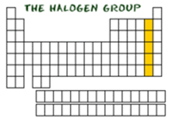
Group 17: The Halogens
The elements in group 17 of the periodic table are the halogens.
Group 17 elements react with metals to form salts.
Since halogens react quickly with other elements, they occur naturally only as compounds.
In general, halogens are less reactive as you move down the group of the periodic table.

Slide 26
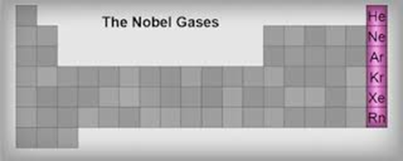
Group 18: Noble Gases
The elements in group 18 of the periodic table are the noble gases.
The noble gases include helium, neon, argon, krypton, xenon, and radon.
The noble gases react with other elements only under special conditions.

Slide 27
Metalloids
The metalloids are elements that have physical and chemical properties of metals and nonmetals.
Metalloids include boron, silicon, germanium, arsenic, antimony, tellurium, polonium, and astatine.
At high temperatures, semiconductors conduct electricity as well as metals.

Slide 28
Metalloids
At low temperatures, semiconductors do not conduct electricity well.
Semiconductors are useful in computers, televisions, and other electronic devices.
The main metalloids used in microchips are silicon and germanium.

Slide 29
Let’s Add These Notes to our Book
Pg 33 – “Periodic Table Basics”
  Glue the first page of today’s notes on this page

Slide 30
Exit Quiz #15 Preparation
Grab an index card and a Periodic Table mat!
Write the following:
  Full Name
  Date
  Class Period
  Exit Quiz #11
Number the card from 1 to 6

Slide 31
Exit Quiz #15
Grab your Plicker sheet or use the one on the back of your notebook!
Hold your Plicker up to show your answer at the top of the sheet!

Slide 32
Exit Quiz #11 (Use page 32)
What group (number) are the following elements located in?
1. Iodine _______________
2. Ca __________________
3. Rb ___________________
4. Name 1 metal.
5. Name 1 nonmetal
6. Name 1 metalloid

